Slide 1
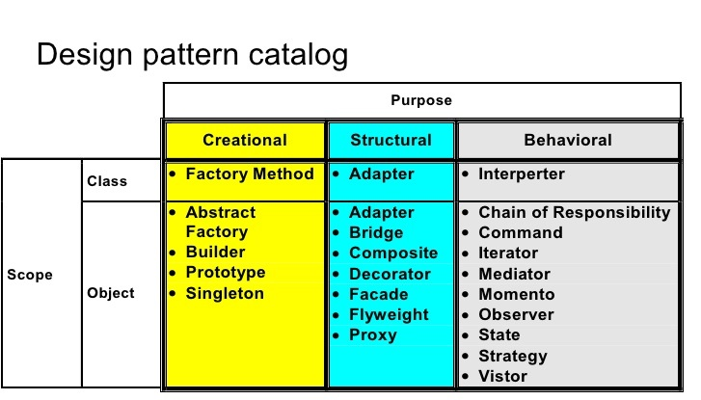
Group One Library Management System
Introduction
Demand of software has been increasing day by day. Therefore, there is more demand for software development paradigm that improves quality and productivity of software development.
Design pattern is a general repeatable solution to a commonly occurring problem in software design.

Slide 2
Problem System and Analysis.
We have taken very simplified version of library Management System that Managed the catalog of a library.
We create an application first then we could build a framework.
We used seven design pattern to build our Framework
Factory Method pattern
Strategy pattern
Singleton pattern
Façade pattern
Adapter pattern
Command pattern
Iterator pattern

Slide 3
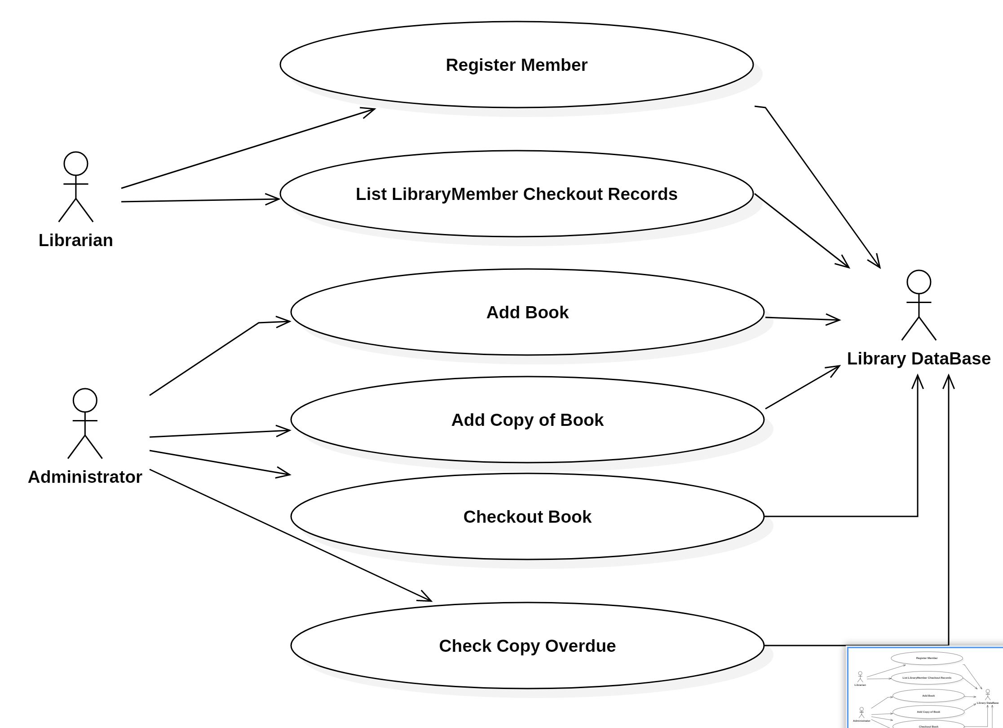
Library System Use Case Diagram

Slide 4
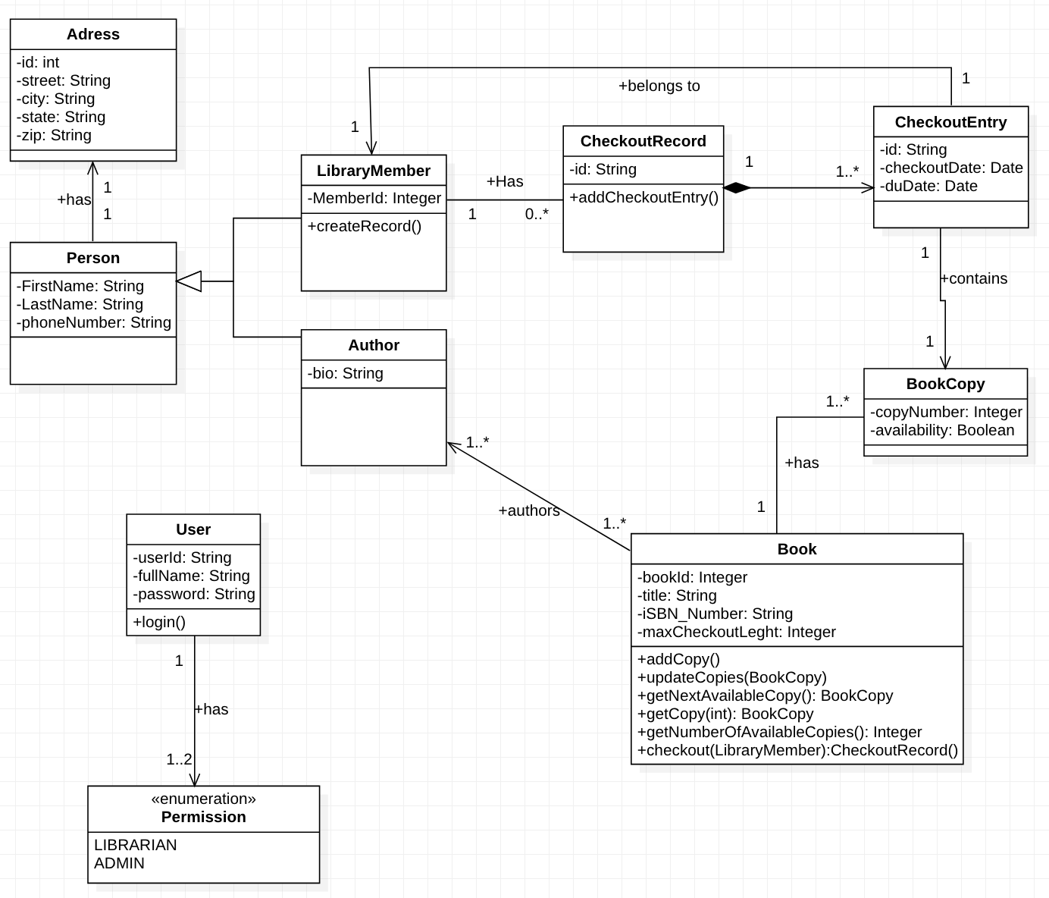
Class Diagram
Library System

Slide 5
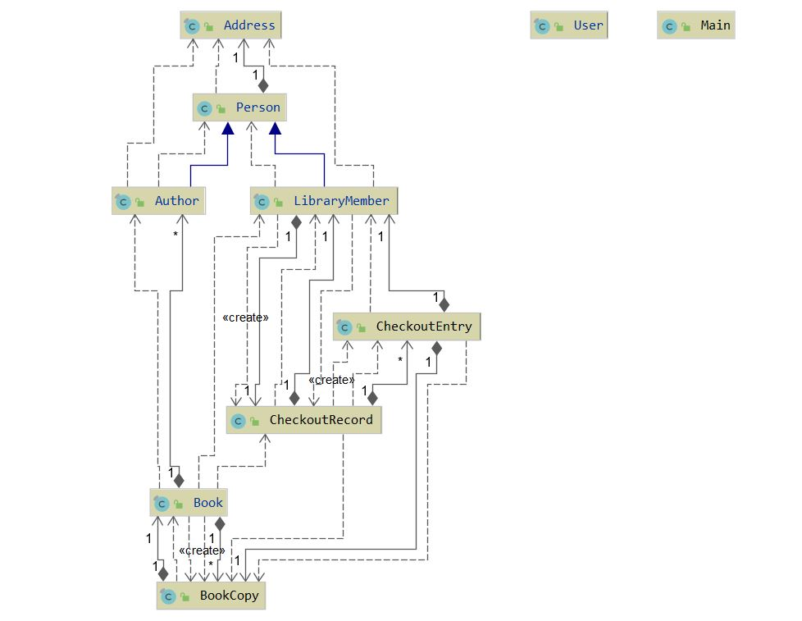
The Business Part of Framework
The business part of the framework contains only the application part which will use or Framework.
The business is the Application part of our project which contains,
Address, Person, Autor, Library Member, Checkout Entry, Checkout Record, Book, Bookcopy.

Slide 6

MAIN KEY POINT OF OUR LIBRARY FRAMEWORK
The framework is developed to make Library Application development easy for application developers across different platforms.
The framework exposes four major APIs/services:
UserService – to manager users
BookService – to manage books
AuthorService – to manage authors
CheckOutService – to manage book checkouts
The developer can specify which and where to save records : Flat File or Relational Database
The framework makes use of design patterns : Command, Factory Method, Singleton, Façade, Adapter, Strategy and Template patterns

Slide 7
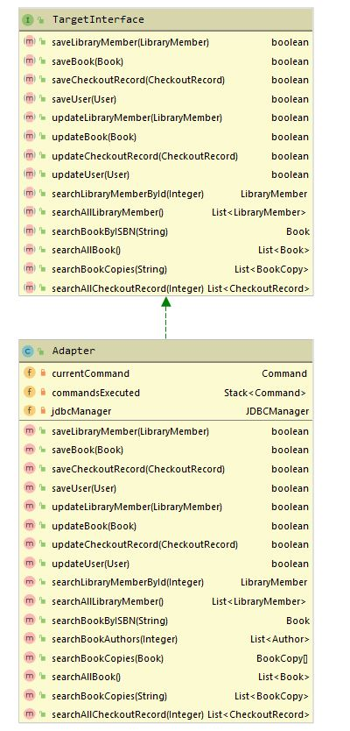
The Adapter Design Pattern
The adapter pattern convert the interface of a class into another interface clients expect. Adapter lets classes work together that couldn’t otherwise because of incompatible interfaces.
In our framework we could apply Adapter patter by adapting the methods in the Adaptee JDBCManager we could adapt multiple methods of JDBCManager.

Slide 8
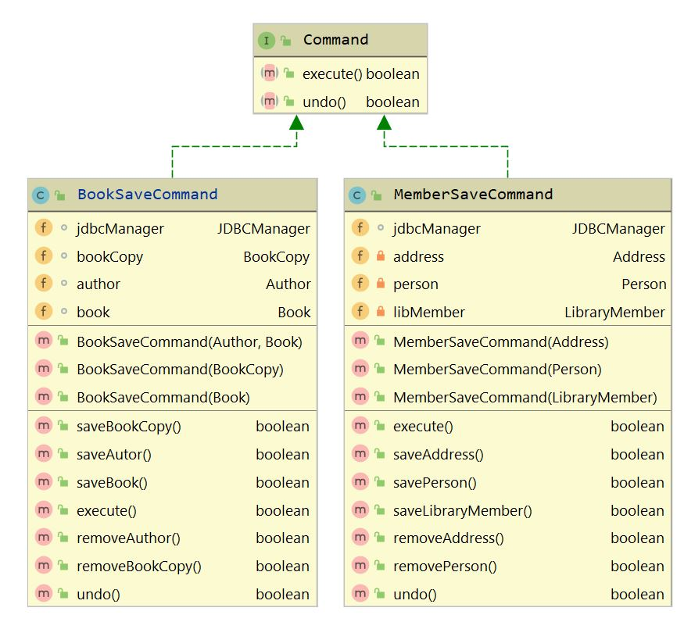
The Command Design pattern.
The command pattern encapsulates a request as an object, thereby letting us parameterize other objects with different requests, queue or log requests, and support undoable operations.
We used the command design pattern, to execute an operation both on BookSaveCommand to save book and MemberSaveCommand to save libraryMember appropriately at run time.

Slide 9
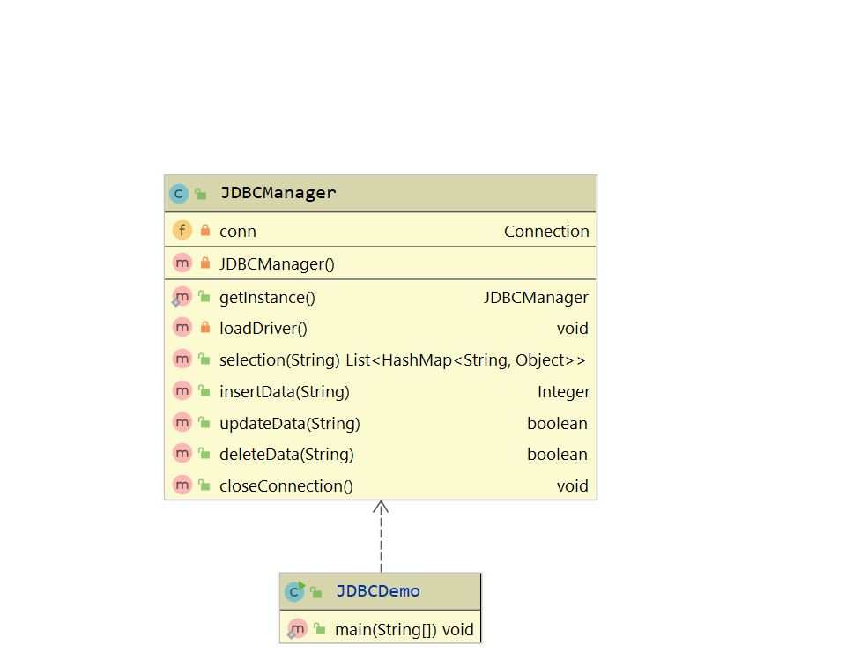
The Façade Design Pattern
Facade pattern hides the complexities of the system and provides an interface to the client using which the client can access the system. This type of design pattern comes under structural pattern as this pattern adds an interface to existing system to hide its complexities.
This pattern involves a single class which provides simplified methods required by client and delegates calls to methods of existing system classes.
We apply façade design pattern by JDBCManager Context class which has bunch of methods, which creates an instance of several Class, this will help Client to invoke this Class instead of invoking several classes to create an object.

Slide 10
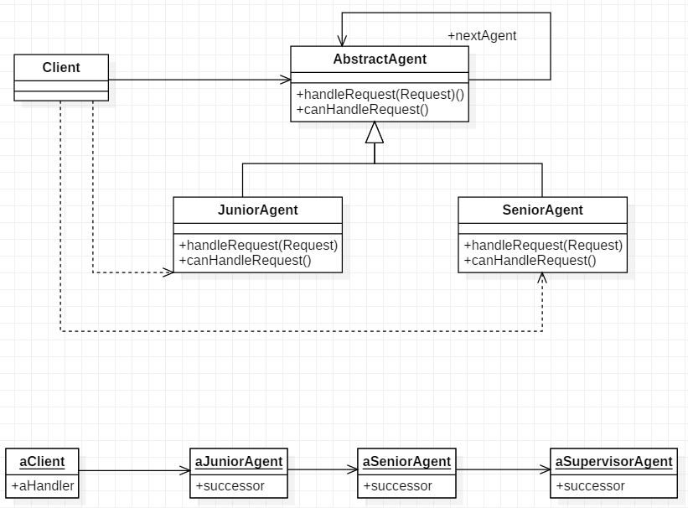
The Chain Of Responsibility Pattern
We applied the chain of responsibility pattern, to create AbstractAgent, the client will not know have aware what going behind, If the JuniorAgent can’t handle the request the successor will be SeniorAgent.

Slide 11
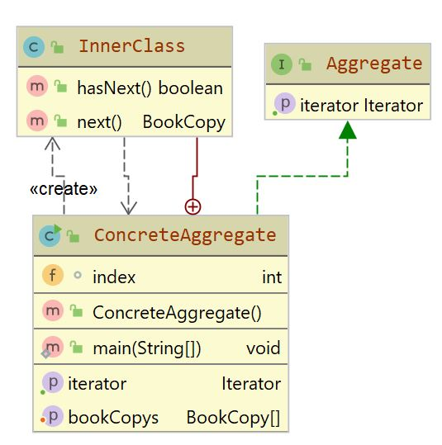
The Iterator Design Pattern
Iterator pattern is very commonly used design pattern in Java environment. This pattern is used to get a way to access the elements of a collection object in sequential manner without any need to know its underlying representation.
Iterator pattern falls under behavioral pattern category.
We applied the Iterator design pattern to traverse the element of array of BookCopy in order to access them every elements in the array.

Slide 12
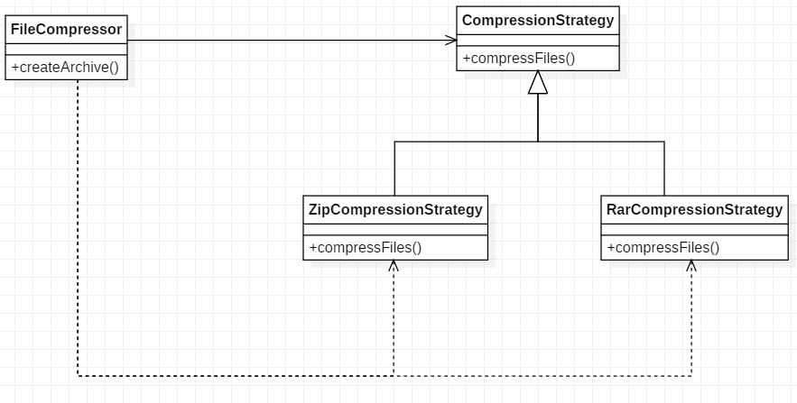
The Strategy Design Pattern
We applied Strategy pattern, In our FileCompressor class.
The FileCompressor class is our context and the CompressionStrategy is our Strategy.
The ZipCompressionStrategy and RarCompressionStrategy Class are ConcreteStrategy which overrides the compressFile() abstract method.

Slide 13
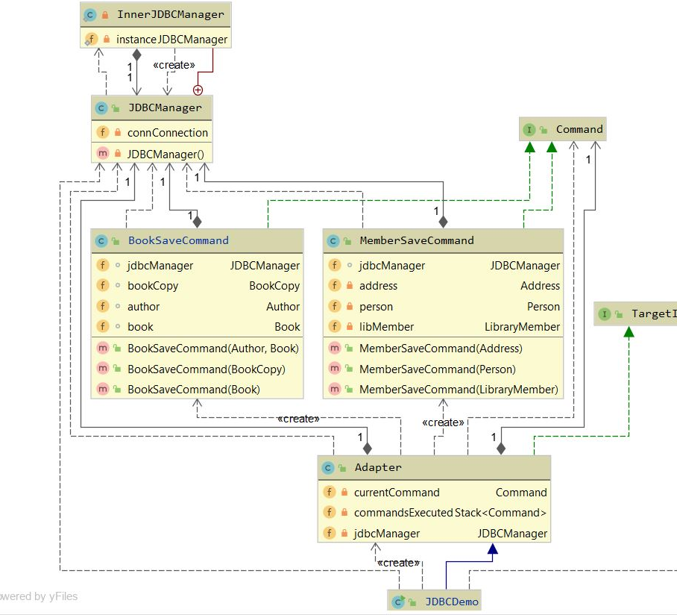
General Structure of Library Management Framework
In our project, We have got few problems in design proposed without using design patterns. This design is then improved using seven design patterns: factory, strategy, singleton, façade, adaptor, command, Iterator design patterns.
To improve the design firstly we added factory pattern to delegate responsibility of issuing book to JDBCManager. Then, facade pattern is implemented to hide the complexities of entire system and provide interface to user, using which the user can access the system. Finally, adapter and strategy with iterator pattern applied.

Slide 14
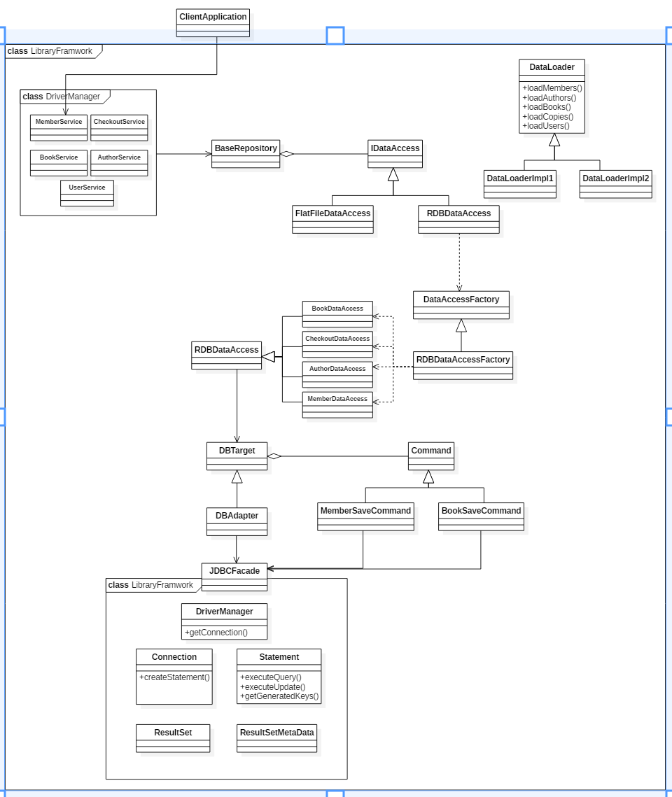
Notes:
THE FRAMEWOR DESIGN PATTERN

Slide 15
GROUP MEMBERS
Emmanuel Cadet (ecades@mum.edu)
Musiliu Adeniyi Bolaji (mabolaji@mum.edu)
Aaron Gezai (agezai@mum.edu)

